Slide 1
CHAPTER 10
Arbitrage Pricing Theory and Multifactor Models of Risk and Return

Slide 2
Single Factor Model
Returns on a security come from two sources:
  Common macro-economic factor
  Firm specific events
Possible common macro-economic factors
  Gross Domestic Product Growth
  Interest Rates

Slide 3
Single Factor Model Equation
r_{i} = Return on security
β_{i}= Factor sensitivity or factor loading or factor beta
F = Surprise in macro-economic factor
(F could be positive or negative but has expected value of zero)
e_{i} = Firm specific events (zero expected value)

Slide 4
Multifactor Models
Use more than one factor in addition to market return
  Examples include gross domestic product, expected inflation, interest rates, etc.
  Estimate a beta or factor loading for each factor using multiple regression.

Slide 5
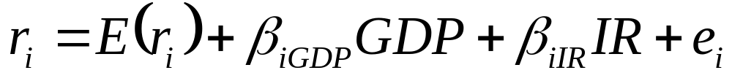
Multifactor Model Equation
r_{i} = Return for security i
β_{GDP} = Factor sensitivity for GDP
β_{IR} = Factor sensitivity for Interest Rate
e_{i} = Firm specific events

Slide 6
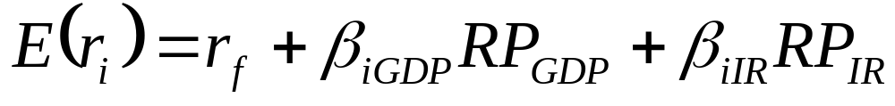

Multifactor SML Models
  _{GDP} = Factor sensitivity for GDP
  RP_{GDP} = Risk premium for GDP
  _{IR} = Factor sensitivity for Interest Rate
  RP_{IR} = Risk premium for Interest Rate

Slide 7
Interpretation
The risk-free rate
The sensitivity to GDP times the risk premium for bearing GDP risk
The sensitivity to interest rate risk times the risk premium for bearing interest rate risk
The expected return on a security is the sum of:

Slide 8
Arbitrage Pricing Theory
Arbitrage occurs if there is a zero investment portfolio with a sure profit.
Since no investment is required, investors can create large positions to obtain large profits.

Slide 9
Arbitrage Pricing Theory
Regardless of wealth or risk aversion, investors will want an infinite position in the risk-free arbitrage portfolio.
In efficient markets, profitable arbitrage opportunities will quickly disappear.

Slide 10
APT & Well-Diversified Portfolios
r_{P} = E (r_{P}) + β_{P}F + e_{P}
F = some factor
For a well-diversified portfolio, e_{P}
  approaches zero as the number of securities in the portfolio increases
  and their associated weights decrease

Slide 11
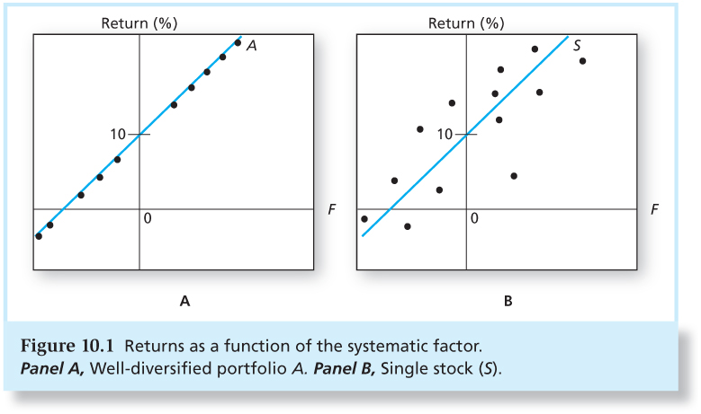
Figure 10.1 Returns as a Function of the Systematic Factor

Slide 12
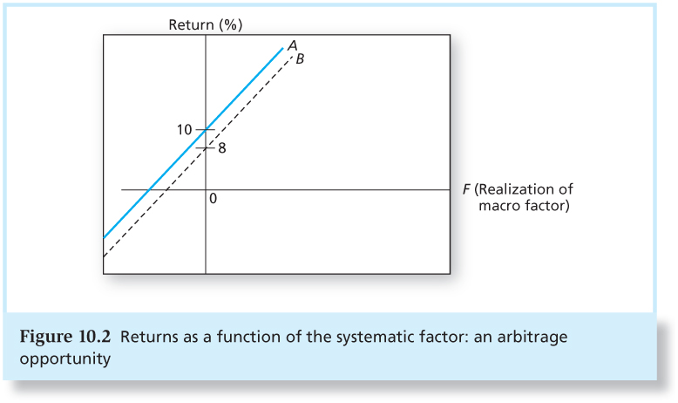
Figure 10.2 Returns as a Function of the Systematic Factor: An Arbitrage Opportunity

Slide 13
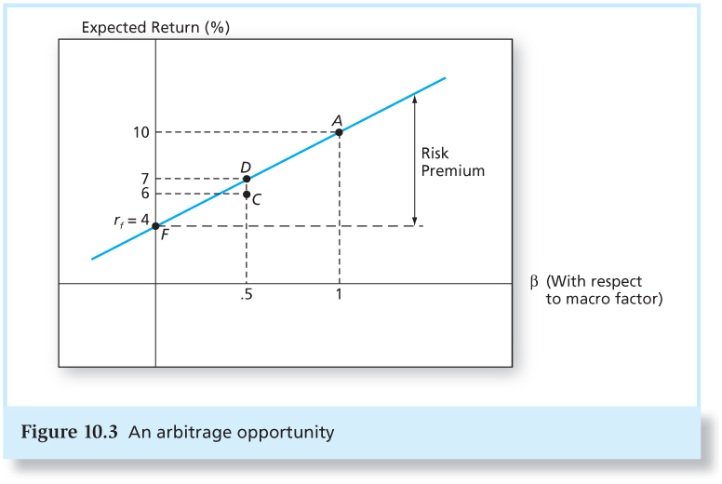
Figure 10.3 An Arbitrage Opportunity

Slide 14
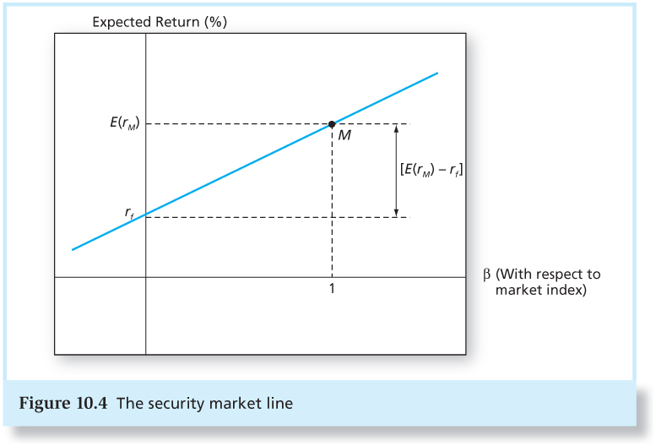
Figure 10.4 The Security Market Line

Slide 15
APT Model
APT applies to well diversified portfolios and not necessarily to individual stocks.
With APT it is possible for some individual stocks to be mispriced - not lie on the SML.
APT can be extended to multifactor models.

Slide 16
APT and CAPM
APT
CAPM
Equilibrium means no arbitrage opportunities.
APT equilibrium is quickly restored even if only a few investors recognize an arbitrage opportunity.
The expected return–beta relationship can be derived without using the true market portfolio.
Model is based on an inherently unobservable “market” portfolio.
Rests on mean-variance efficiency. The actions of many small investors restore CAPM equilibrium.
CAPM describes equilibrium for all assets.

Slide 17
Multifactor APT
Use of more than a single systematic factor
Requires formation of factor portfolios
What factors?
  Factors that are important to performance of the general economy
  What about firm characteristics?

Slide 18
Two-Factor Model
The multifactor APT is similar to the one-factor case.

Slide 19
Two-Factor Model
Track with diversified factor portfolios:
  beta=1 for one of the factors and 0 for all other factors.
The factor portfolios track a particular source of macroeconomic risk, but are uncorrelated with other sources of risk.

Slide 20
Where Should We Look for Factors?
Need important systematic risk factors
  Chen, Roll, and Ross used industrial production, expected inflation, unanticipated inflation, excess return on corporate bonds, and excess return on government bonds.
  Fama and French used firm characteristics that proxy for systematic risk factors.

Slide 21
Fama-French Three-Factor Model
SMB = Small Minus Big (firm size)
HML = High Minus Low (book-to-market ratio)
Are these firm characteristics correlated with actual (but currently unknown) systematic risk factors?

Slide 22
The Multifactor CAPM and the APT
A multi-index CAPM will inherit its risk factors from sources of risk that a broad group of investors deem important enough to hedge
The APT is largely silent on where to look for priced sources of risk

